Slide 1
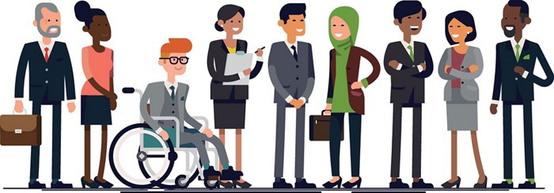
Diversity, Inclusion & Risk
Notes:
1 hour 35 Minutes
Objectives: Participants are able to define how individual profiles affect the risks
Participants can discuss how risks affect individuals and what measures are appropriate to ensure all staff have a safe place to work

Slide 2
Introductions and Expectations
Notes:
17 minutes
As the topics for the day are quite personal, need to spend time for people to get to know each other and feel comfortable in the group.
Introduce facilitators, ask participants to introduce themselves (5 mins).
Divide participants into groups of 3 – 4, ask them to introduce themselves and discuss their expectations (7 mins)
Plenary feedback of expectations (5 mins)

Slide 3
Who I am
Physical Appearance:
Skin colour, size, age, etc
Beliefs, Biases, Values
Gender Identity
Ethnicity
Nationality
Behaviour
Sexual / emotional attraction
Subordinate or privileged
Religion
Biological Sex
Socio-economic Status
Disabilities: Physical, mental, phycological, cognitive, etc.
Visible Invisible
Notes:
3 minutes slides 3 & 4
Everybody has multiple different profile characteristics which impact on the way security risks will affect them.
These characteristics are both visible and invisible
First we are going to look at gender in more detail – but the principles apply to all profile characteristics

Slide 4
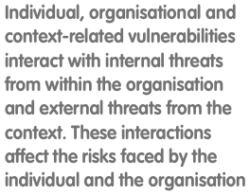
Organisation Duty of Care
Role & Organisation
Context
Individual
All Staff
International and Relocated Staff
Security Risk Management for Staff with Diverse Profile – EISF 2018
Notes:
3 minutes slides 3 & 4
Your organisation has duty of care responsibilities to you and all of your colleagues, no matter who you are, but they will vary.
For all staff there are risks associated with who they are and who the organisation is and what it does. For example if you are a staff member working on gender sensitive programmes in a conservative society, there may be risks to you because of that.
However for staff that have been relocated – i.e. the organisation has moved you to a specific location away from your home area, whether international or local – the organisation will also have responsibility those staff where risks are associated with who they are and where they are.
For example, you may be diabetic and working in a location where there are reduced medical facilities.
This does not mean you should not work there, but additional measures may be required to manage that risk.

Slide 5
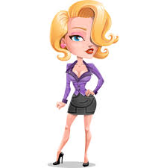
Personal Profile Group Work
How do you think others will perceive you because of what you look like within the contexts you will work?
How might others perception of you differ from your perception of yourself and how might this impact your security?
What are your biggest security concerns?
What would you hope to get from your organisation and colleagues to support you in dealing with these concerns and different risks?
Notes:
20 minutes
And while in the West, gender is now seen as much more of a scale with a greater variety of positions recognized, rather than just a binary position, in most of the countries we work, this is less likely to be the case. Assumptions will be made on how we look, particularly in terms of gender.
Group Work.
2 minute introduction and divide
10 minute group work
8 min feedback and discussion for each group.
Facilitator support allocates members into 2 groups – male and female – sends participants to groups
Have one facilitator with each group – assuming you have male and female facilitator
Facilitator Support shares questions in chat
Once in groups, ask participants to consider the questions
Facilitator support gives 2 min warning before end of group work
Facilitator support recalls participants after 10 mins
Feedback from each group by facilitators
Discussion of any points that may have raised by both or where different perspectives or areas of one group that the other did not consider
Things to consider if conversation is difficult to get going
Female Group
Harassment on a day to day basis, rather than extreme sexual violence. Will be covered more later
Security reviews often don’t capture things that concern women, e.g. hotels that meet security rules but have ‘creepy’ staff that make it uncomfortable for women to stay (or lots of porn on TV)
Generally women do not like to eat alone in places they don’t know
In conservative societies if male national staff have free range in accommodation women may not be able to wear what they wish – permanently on show.
Cultural norms
Male group
Targeted by local women looking for a ‘sugar daddy’
Protection tendencies towards female colleagues
not wanting to admit any weakness
Bullying and harassment
How to deal with sexual violence against female colleagues
Sexual violence against men
Cultural norms

Slide 6
Internal vs External Threats
When aid workers spoke about security risks associated with ethnicity, they were most concerned about external threats
HOWEVER
Aid workers who identify as LGBTQI or as a person with a disability were more concerned about internal threats to their security.
Security Risk Management for Staff with Diverse Profile – EISF 2018
Notes:
5 minutes slides 6 & 7
Traditionally organizational security planning and mitigation measures have concentrated on external threats – threats that have been initiated outside of the organisation and targeted at staff, assets and programmes because of who the organisation is and what the organisation does.
But what threats you are most concerned about will depend on who you are. Findings from the EISF research paper on Security Risk Management for Staff with Diverse Profiles found:
So when we look at personal security we need to consider both internal as well as external threats.
Statistically security managers have been middle-age, heterosexual, white men. And while there is nothing wrong with middle-age, heterosexual, white men per se – It can be difficult for them to understand what the threats and concerns might be for you – as an individual with all your different personal characteristics. Therefore it is important you understand:
Who you are
What your vulnerabilities might be
What does this mean in the context you are working – for example being gay in Uganda is illegal. You may not wish to tell you organisation / colleagues you are gay – that is absolutely fine – but if you are gay, you do need to be aware of what the implications of this on your personal security could be if you went to work in Uganda
And - Who to talk to in your organisation to make sure your concerns are addressed – Do you talk to staff in Human Resources? is it your line manager?
It may vary from person to person, but make sure you know what the options are to look after yourself.

Slide 7
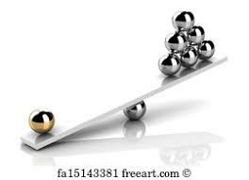
Diversity and Inclusion
Notes:
5 minutes slides 6 & 7
While it is important to understand our own vulnerabilities and risks, it is also important to understand how our colleagues may be impacted by different threats
Not only how these affect them as individuals and so how we support them,
but also what impact this might have on the team.
And from a completely selfish perspective, what impact this might have on us.
We need to consider both internal and external threats.

Slide 8
BREAK
Notes:
5 minutes

Slide 9
Group Work
Divide into groups
Each person in the group is given a person profile
As the scenario unfolds participants should discuss what their security concerns might be based on the personal profile they have been given
At each stage group members should discuss what they would need to feel secure
Feedback and discussion at end of scenario
Notes:
30 minutes Slides 9-12
Facilitator Support - Establish random groups of 3 or 4
Explain exercise
Facilitator Support – share a different personal profile outline with each participant through private chat,
Facilitator Support – send participants to groups
As the scenario unfolds participants should discuss what their security concerns might be based on the personal characteristics they have been given and explain why they would have those concerns.
At each stage group members should discuss what they would need to feel secure
5 minutes discussion per scenario – 3 parts
10 minutes plenary after scenario completed
Share 1 profile with each participant privately through Chat. Make sure each member of a particular group has a different profile.
Female, white, Christian, age 37, heterosexual. Physically and mentally fit. Last posting went very well and you are excited about starting this new position.
Male, white, agnostic, age 32, heterosexual. Towards the end of your last posting, you were robbed at gunpoint at the hotel you were staying. During the attack you were badly beaten. While you have fully recovered physically from the ordeal, it has taken longer to recover from the trauma. You have been receiving therapy and agreed with your therapist you are ready to go back into the field. You are happy to be back doing work you love, but you are a little apprehensive about how you might react if something goes wrong.
Male, black, Christian, age 30, homosexual. Physically and mentally fit. While you have decided that you are willing to keep your homosexuality hidden, the growing number of homophobic articles in the press have worried you and you are appalled at the lack of human rights for homosexuals in the country you will be working.
Female, Asian ethnicity, age 47, heterosexual. Brought up a Muslim but no longer practicing. You suffer from epilepsy and this has been discussed with human resources and it has been agreed that this is not a problem as the medication you take keeps the attacks to a minimum. You have asked HR not to reveal your illness to others as you do not want to feel any pity. You were unable to source more than 3 months supply of your medication but have been told it is readily available in the country. You are not concerned but do know that if you are ill and stressed attacks may be more likely.
Female, white, age 27, lesbian, agnostic. You have discussed your sexuality with human resources and they have assured you that, as long as your behaviour is low-key, there should not be a problem, the homo-phobic rhetoric in the local press is very male targeted. You have a physical disability which has weakened your right side. It is not obvious and does not limit normal day to day activities but means you have limited movement in your right arm and cannot run very easily.

Slide 10
Scenario - Context
You are about to join a programme team in a conservative country whose population is approx. 50% Muslim, 40% Christian and 10% traditional Humanist. Generally all the groups get on well together, but there has recently been targeted ethnic attacks in the capital city.
There are rumours that these may be being provoked by an ISIS cell, as there have been some arrests here and in the neighbouring country.
While there is a well educated, middle-class community in the large cities, the country as a whole is shifting to a more conservative, internal looking, stance.
This has been reflected in women, of all ethnicities, being harassed if not very conservatively dressed. And growing rhetoric in the press to enforce anti-homosexual legislation
Infrastructure in the country is poor, with the only tar roads in the capital city and very limited medical facilities outside of the capital.
You are travelling on your own to a new posting where you will be embedded in the local Caritas office based 100km from the capital. It is not your first posting but it is the first in a culture very different from your own.
Notes:
30 minutes Slides 9-12
Introduction to group work and divide into groups – 5 mins
Group work 1 – 6 mins
Scenario 2 – 2 min
Group work 2 – 6 mins
Plenary discussion 10 mins
Read out Context in plenary

Slide 11
Scenario
You have been in-country 3 weeks and are attending your first monthly meeting where the local Priest comes in and talks with the whole office.
The Priest starts with a prayer and talks about how happy they are to have you joining the team and are really excited about working with and learning from you.
He then starts talking about the importance of upholding good Christian Values, which he summarises as the demure and conservative behavior of women and the abhorrence of homosexuality.
How do you feel? What do you do?
Notes:
30 minutes Slides 9-12
6 mins discussion in groups
Read out Scenario
Facilitator Support – send participants to random groups
Facilitator support recalls participants after 5 mins, with 1 min warning

Slide 12
Scenario
You have been in post for 3 months and have not been feeling well for a few days. You are feeling distinctly worse today. You have run out of the medicines your brought with you and there is nothing available in the office location.
It is 2pm on a Friday, and this is your last chance to get to the capital city with the staff driver before the weekend, your next opportunity to travel will be on Monday.
However, you are supposed to be attending an important meeting with local government officials at 3.00pm. The official has promised to confirm whether they will finally give you permission to expand your programmes. The official has made it clear that permission is dependent on clear sign of support from the international community of which they see you as the representative.
What do you do?
Notes:
30 minutes Slides 9-12
6 mins discussion in groups
Read out Scenario
Facilitator Support – send participants to random groups
Facilitator support recalls participants after 5 mins, with 1 min warning
10 min plenary discussion.
Bring out how it felt to be in somebody else’s shoes.
The importance of understanding ourselves and others in order to create a safe working environment.

Slide 13
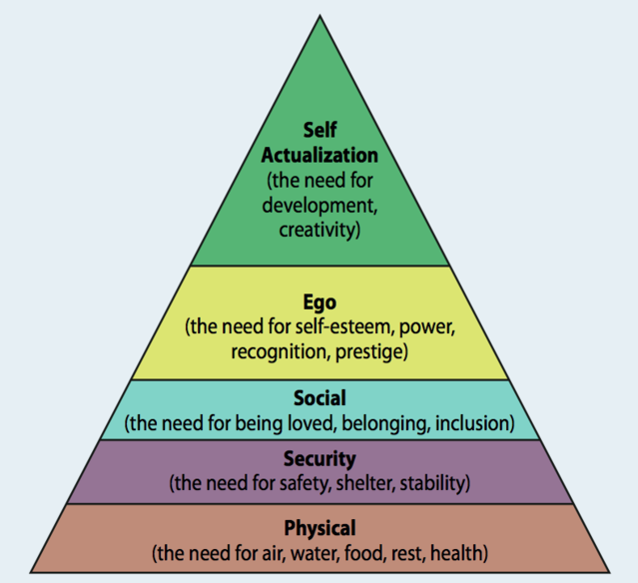
Maslow’s Hierarchy of Needs
Notes:
5 minutes
Why is this important?
You will probably recognize Malsow’s hierarchy of needs. The basis human needs are for physical and psychological safety, if these are not met, you can not be an effective and useful staff member.
It is important to feel safe and secure and not to just be told that you are.
The more information and knowledge you have, for example around the context and you position in it, the more secure you will feel
Knowing what to do if … and what your organisation will do if …. Builds trust and again increases your security as well as your felling of being safe.
This is the responsibility of yourself as well as your organisation.

